Slide 1


Department of ECE
College of Engineering Guindy, Anna University, Chennai
EC23702 – Mini Project
Final Review
30-10-2026
Hardware Implementation of Modules of Dual branch 2D CNN architecture
Under the Guidance of:
Dr. C.M. Sujatha
Professor
Department of ECE
CEG Campus, Anna University
Project Members:
Eshaanjana S (2023105011)
Meganath Vishwa M (2023105033)
Kannan S A (2023105538)
Vinothini K (2023105552)

Slide 2

Layout
Introduction
Problem Statement
Objectives
Proposed Methodology
Implementation
Results
References

Slide 3
Introduction
A Convolutional Neural Network (CNN) is a deep learning algorithm specifically designed for processing image data.
It automatically learns important features such as edges, textures, shapes, and objects directly from images without requiring manual feature extraction.
CNNs use convolution, activation, and pooling operations to progressively extract meaningful features, enabling accurate image classification and object recognition.
Due to their high accuracy and computational efficiency, CNNs are widely used in applications such as medical image analysis, autonomous vehicles, facial recognition, surveillance, and industrial defect detection.
Unlike CPUs and GPUs, FPGAs enable parallel and pipelined execution of convolution operations, significantly reducing processing latency. So were using FPGA in implementing this CNN accelerator.

Slide 4
Problem Statement
Conventional CNN architectures perform convolution sequentially one kernel be kernel, which results in high computational complexity and longer processing time.
For any convolution operation, same pixel has to be fetched many times. Repeated access to the same input pixels increases memory bandwidth requirements and processing latency.
Kernels or image will contain Zero-valued weights. Processing zero-valued weights causes unnecessary MAC operations, leading to higher DSP utilization, increased power consumption, and reduced hardware efficiency.

Slide 5
Objectives
To design and implement modules of Dual Branch 2D-CNN architecture at the Register Transfer Level (RTL) using Verilog.
To develop a Parallel-Quantized-Pixel-wise (PQP) module that processes multiple pixel multiplications simultaneously.
To implement Skip-Zero-Weight (SZW) logic that dynamically disables MAC computations when a filter weight is zero, saving DSP usage.
To design a Function-Merging Add-Pool Unit that executes addition and max-pooling in the exact same hardware stage, eliminating the need to write intermediate data to memory.
To eliminate standard ReLU overhead by leveraging unsigned 4-bit integer (UINT4) calculations, ensuring all intermediate results remain naturally non-negative.

Slide 6
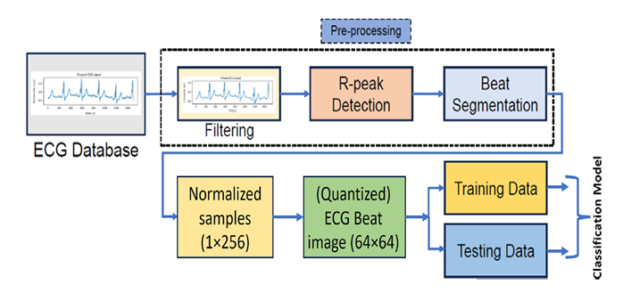
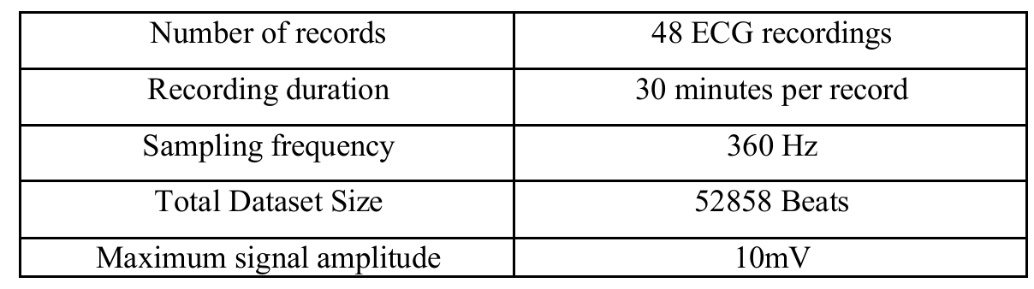
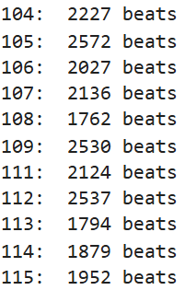
CNN MODEL TRAINING
DATASET DETAILS
Source: PhysioNet - MIT-BIH Arrhythmia Database
Purpose: ECG signal analysis and heartbeat classification
MIT-BIH File contains
.dat – ECG Signal Data: Contains the digitized ECG samples recorded from the patient.
.hea – Header Information: Contains sampling frequency, signal names, and ADC details.
.atr – Annotation Data: Contains beat locations and their corresponding ECG annotation labels.

Slide 7
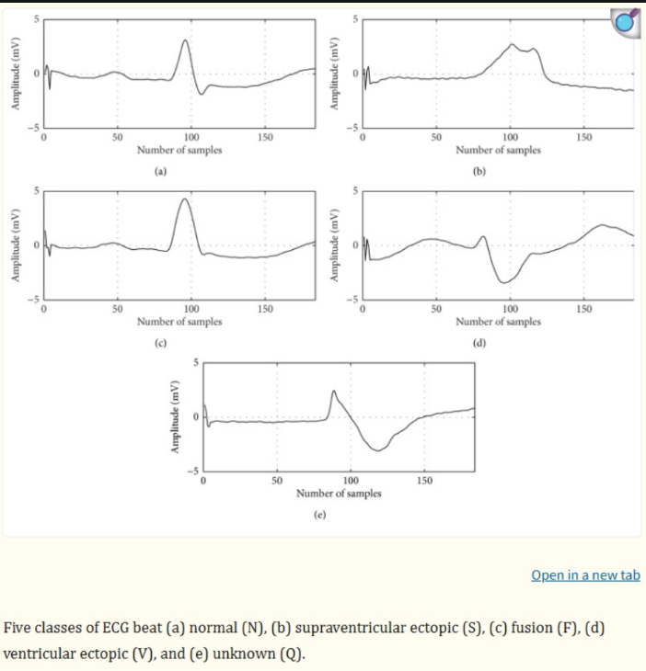
DATASET:
DATASET CLASSIFICATION:
5 ECG Arrhythmia Classes:
N – Normal → Normal heartbeat
S – Supraventricular ectopic beat → Abnormal beat originating above the ventricles
V – Ventricular ectopic beat → Abnormal beat originating in the ventricles
F – Fusion beat → Combination of normal and ventricular beats
Q – Unknown / Paced / Unclassifiable beat → Beats that cannot be clearly classified

Slide 8
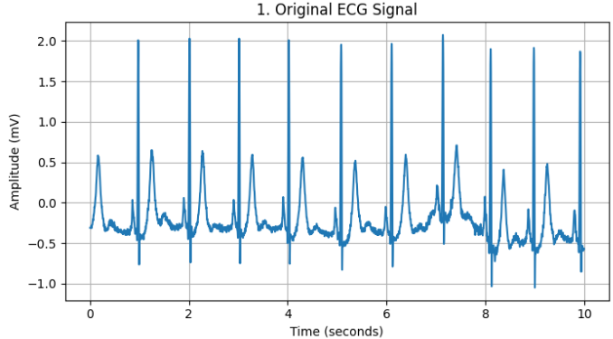
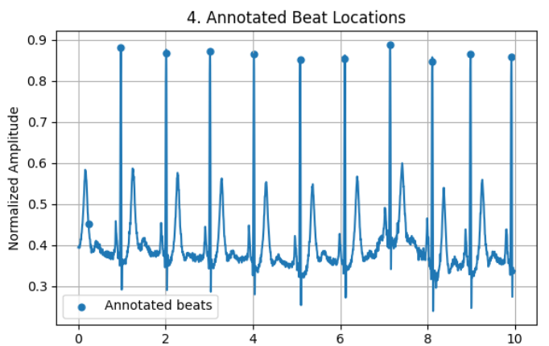
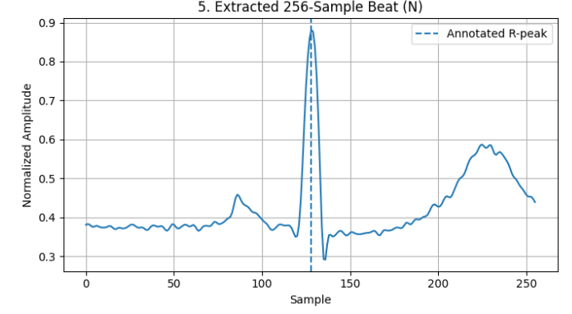
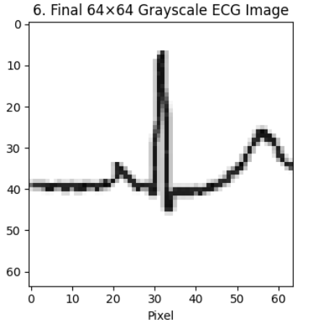
PREPROCESSING:
STEPS:
MIT-BIH ECG Signal
↓
Band-pass Filtering
(0.1 – 100 Hz)
↓
Normalization(0 -1)
↓
Extract Annotated R-Peaks
↓
Extract 256 Samples
Around Each R-Peak
↓
Draw ECG Waveform
↓
Resize to 64 × 64
↓
Input-Training Dataset

Slide 9
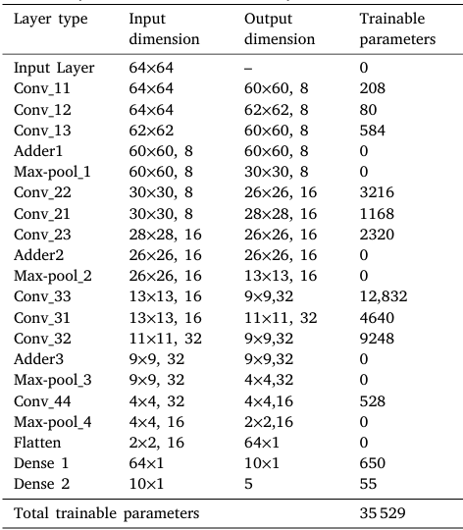
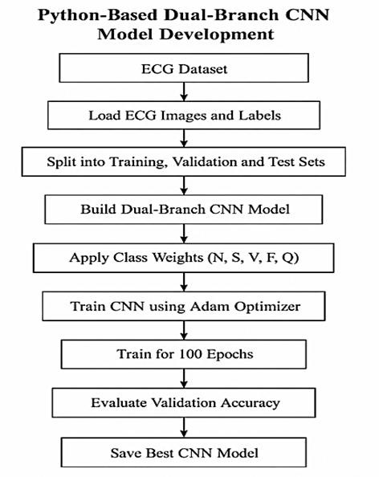

MODEL TRAINING:
STEPS:
Training involves dividing the dataset into training, validation, and testing subsets, applying class weights to address class imbalance, and optimizing the network parameters using the Adam 18 optimizer.
The trained model is evaluated using the test dataset, and its weights and biases provide reference parameters for hardware-oriented implementation.

Slide 10
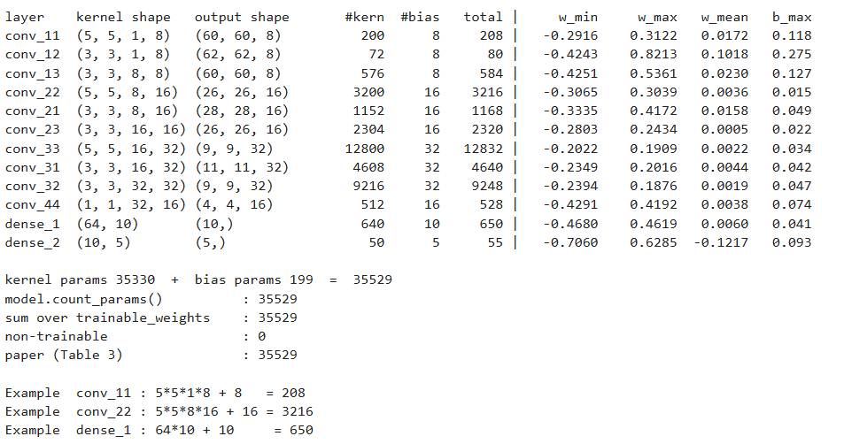
PERFORMACE OF TRAINED MODEL
The software-trained ECG classification model was trained for 100 epochs to classify heartbeats into five categories: N, S, V, F and Q.
The model contains 35,529 trainable parameters, including 35,330 kernel parameters and 199 bias parameters. The convolutional layers perform feature extraction, while the dense layers generate the final five-class output

Slide 11
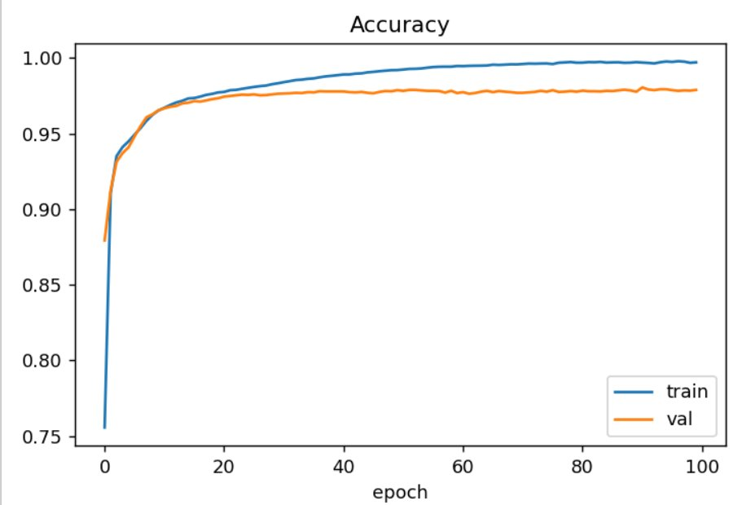
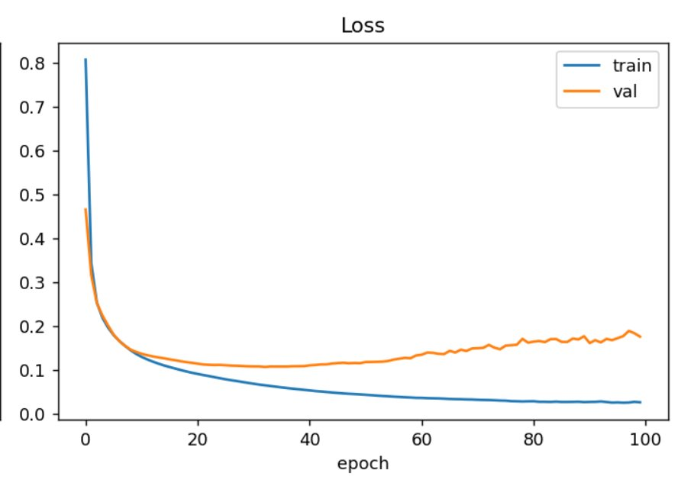
PERFORMACE OF TRAINED MODEL
The accuracy curve shows that training and validation accuracy increase rapidly during the initial epochs and then stabilize, with training accuracy approaching 99%.
The loss curve shows a continuous decrease in training loss, while validation loss decreases initially and rises slightly during later epochs, suggesting possible overfitting.

Slide 12
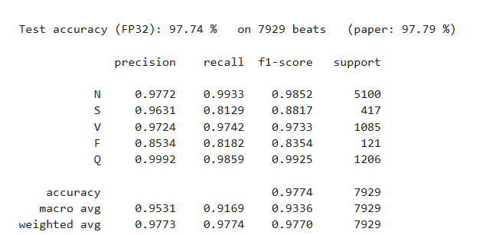
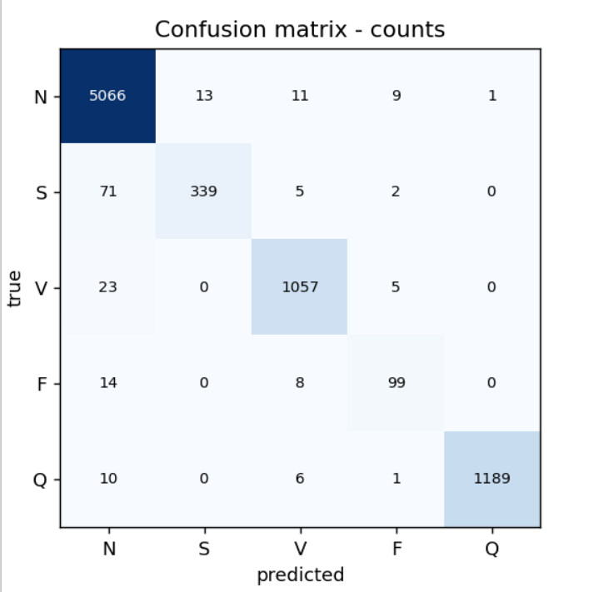
TESTING : CLASS-WISE PERFORMANCE METRICS OF THE ECG CLASSIFICATION MODEL.
The model achieved a test accuracy of 97.74% on 7,929 heartbeats, with precision, recall and F1-scores providing additional insight into class-wise performance.
The results indicate strong overall classification performance, although the S and F classes show comparatively lower recall or F1-scores.
The confusion matrix shows that most samples are correctly classified along the diagonal, while the off-diagonal values represent misclassifications.

Slide 13
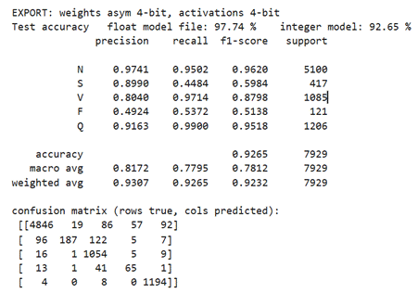
TESTING: CLASSIFICATION PERFORMANCE AFTER INT4 QUANTIZATION
Convert the trained FP32 CNN model into a hardware-efficient integer model for FPGA implementation
The quantized model's classification results indicate a test accuracy of 92.65% using 4-bit weights and activations, compared with 97.74% for the original FP32 model.
The confusion matrix and class-wise metrics show how reduced precision affects classification across the five heartbeat categories.
Activation Precision | Type | Test Accuracy
32 bits | Floating point | 97.74%
6 bits | Integer | 95.50%
4 bits | Integer | 92.65%
The 4-bit quantized model is intended to reduce computational and hardware requirements for FPGA deployment, while retaining useful classification performance for ECG-based analysis.

Slide 14
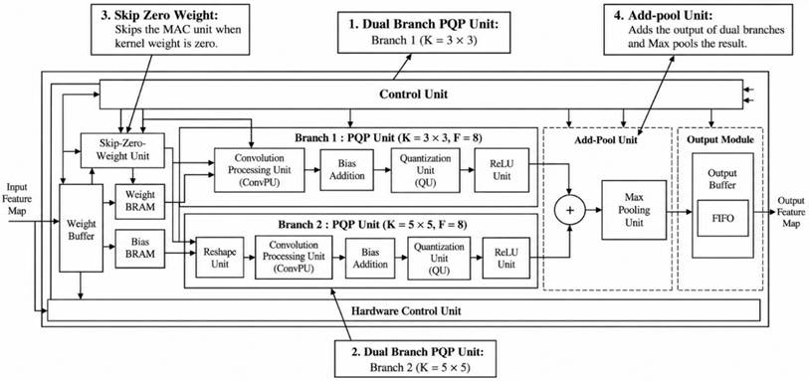
HARDWARE CONTROL ARCHITECTURE

Slide 15
HYPERPARAMETERS OF EACH MODULE
Layer Type | Input Dimension | Ouput Dimension | Connected to
Input Layer (Image) | 512 x 512 | _ | _
Conv_l1 (5 x 5) | 512 x 512 | 508 x 508, 8 | Input Layer
Conv_l2 (3 x 3) | 512 x 512 | 510 x 510, 8 | Input layer
Conv_l3 (3 x 3) | 510 x 510 | 508 x 508, 8 | Conv_l2
Adder | 510 x 510, 8 | 510 x 510, 8 | Conv_l3, Conv_l1
Max Pool | 510 x 510, 8 | 254 x 254, 8 | Adder
The table illustrates the layer-wise architecture of the proposed dual-branch CNN, showing how the input image passes through convolution layers, how their feature maps are combined using an adder, and how max pooling reduces the spatial dimensions. It provides an overview of the data flow and connections between the hardware processing modules.

Slide 16
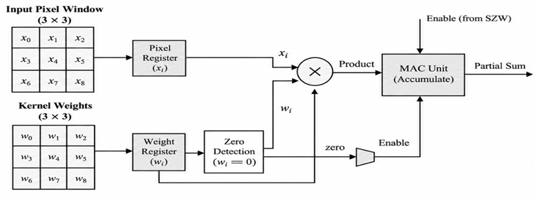
SKIP ZERO WEIGHT ARCHITECTURE
The SZW unit checks the kernel weights before the multiplication and accumulation process. If a weight is zero, the corresponding multiply-accumulate (MAC) operation can be skipped. This approach can reduce unnecessary switching activity and computational effort in the hardware datapath.

Slide 17
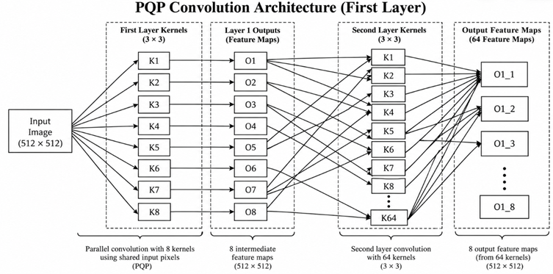
THE PARALLEL-QUANTIZED-PIXEL-WISE (PQP) CONVOLUTION ARCHITECTURE:
As illustrated in the figure, the input image is processed by eight first-layer kernels of size 3x3, generating eight intermediate feature maps. These feature maps are then supplied to the second convolution layer, which uses 64 kernels to perform further feature extraction.
The PQP approach enables parallel processing of shared input pixels, reducing repeated pixel fetching and providing opportunities for improved hardware utilization.

Slide 18
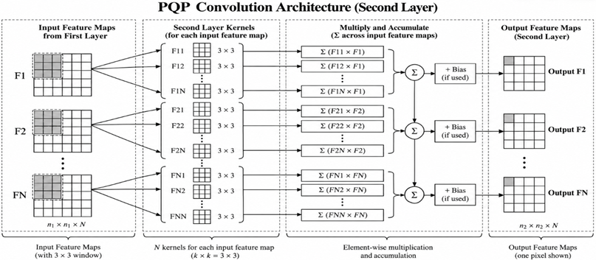
THE PARALLEL-QUANTIZED-PIXEL-WISE (PQP) CONVOLUTION ARCHITECTURE:
Convolution Second Layer:
Pixel Wise Parallel convolution is implemented in second layer of convolution.
Each Pixel is fetched only once and gets multiplied parallelly to the kernels.
The Sum of the products of the each kernels and feature maps gives the output of the second layer.
Second Layer PQP Convolution Architecture

Slide 19
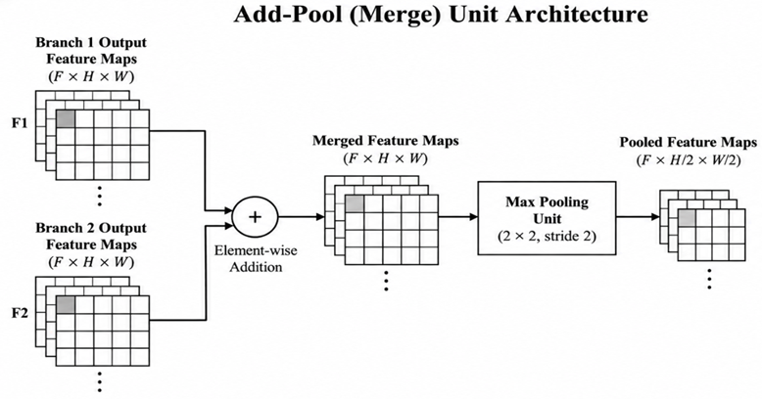
ADD POOL UNIT ARCHITECTURE
The Add-Pool unit combines and performs element-wise addition followed by max pooling, allowing the features extracted by both branches to be merged into a single set of feature maps.
By combining addition and pooling into a single functional unit, the architecture can reduce intermediate data handling and simplify the overall processing flow.

Slide 20
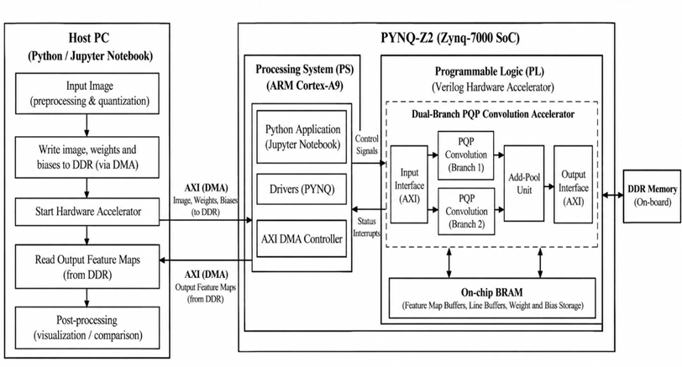
PS – PL INTEGRATED IP DESIGN
The architecture illustrates the complete hardware–software workflow for the proposed dual-branch CNN accelerator on the PYNQ-Z2 FPGA.

Slide 21
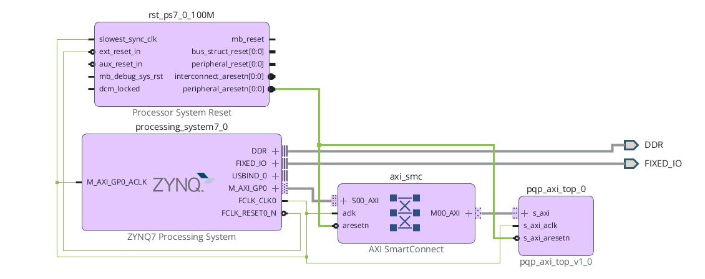
PS – PL INTEGRATED IP DESIGN IN VIVADO
Building on the previous system architecture, the custom PQP accelerator was integrated into the PYNQ-Z2 design using Vivado IP Integrator. The Zynq-7000 Processing System, AXI SmartConnect, reset circuitry, and custom PQP AXI IP were configured and interconnected to establish the hardware interface.

Slide 22
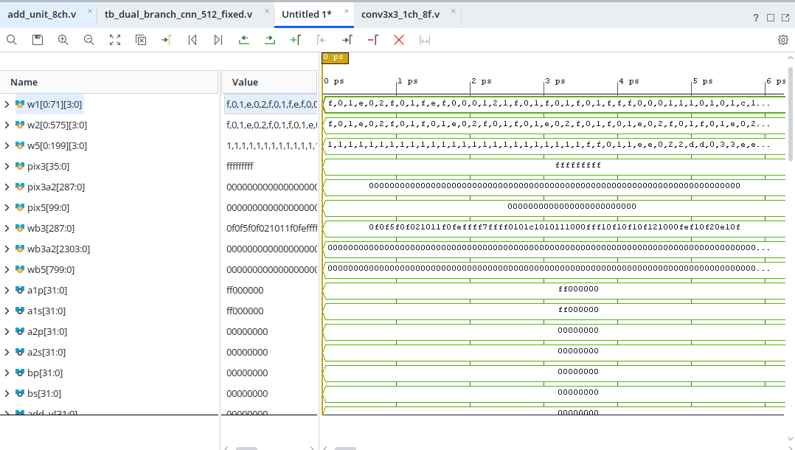
RTL SIMULATION RESULT OF FINAL LAYER
Pixel Values
Weights
Result Value

Slide 23


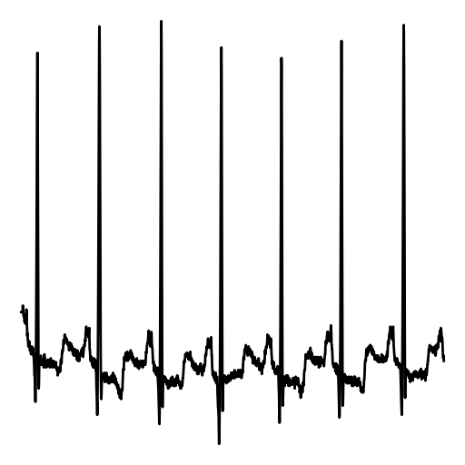
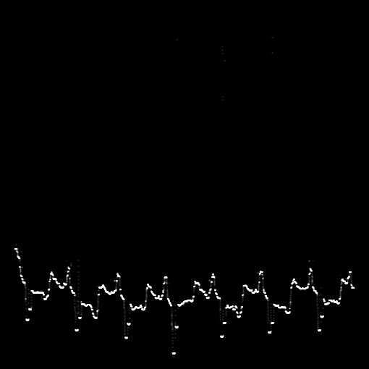
RESULT OF DUAL BRANCH CNN ARCHITECTURE
Sample Calculation:​
First Pixel window Value:
15(-1)+15(-2)+15(-1)+ 15(0)+15(0)+15(0)+15(1)+15(2)+15(1) = 0
*​
Output of Layer 1:
*
K2: Sobel Y ( 3 x 3)
(Horizontal Edge detection)
Output​ Feature Map
510 x 510
Input Image 512 X 512

Slide 24
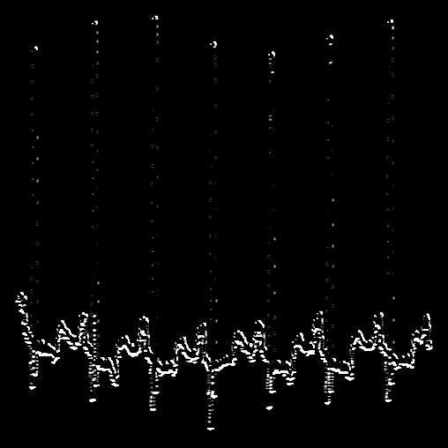
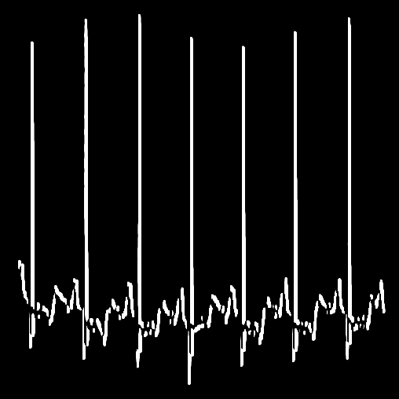
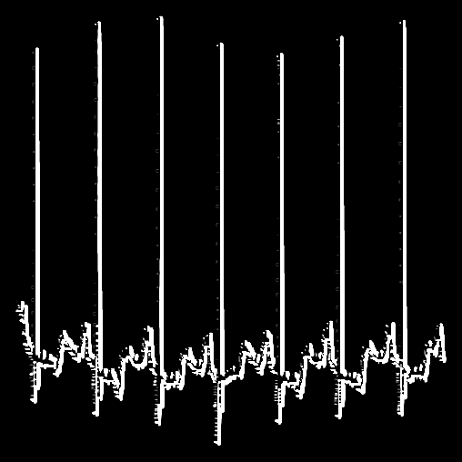
RESULT OF DUAL BRANCH CNN ARCHITECTURE
Similarly the Outputs for second branch and second layer of first branch has been taken.
The Outputs of the two branches are added and gets max pooled by the add pool unit.
+
=
Second Layer Output of Branch 1
508 x 508
Output of the Branch 2
508 x 508
Adder Output
508 x 508

Slide 25
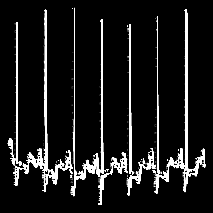
RESULT OF DUAL BRANCH CNN ARCHITECTURE
Output of Add-pool Unit:
Max Pooling
Output (254x254)
Input of Max pool Unit (508x508)

Slide 26
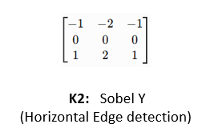
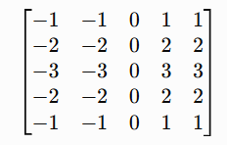
RESULT OF DUAL BRANCH CNN ARCHITECTURE
Sobel 5x5 Branch 2 kernel
(A larger receptive-field directional edge detector.)
Input Image 512 x512
3x3 branch 1 kernel
Max Pooling
+
=
Maxpool Output (254x254)
Second Layer Output of
Branch 1
508 x 508
Output of the Branch 2
508 x 508
Adder Output
508 x 508
First Layer Output of Branch 1
510 x 510

Slide 27
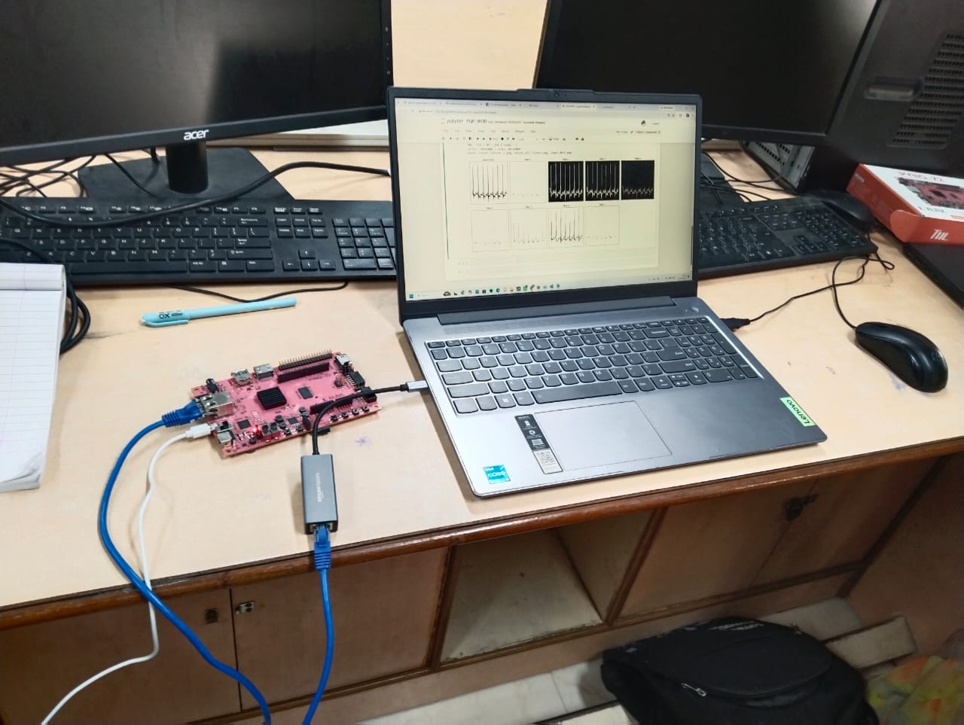
EXPERIMENTAL SETUP
FPGA Board: PYNQ-Z2 development board.
Host System: Laptop connected to the FPGA board.
Connectivity: Ethernet and USB connections for communication and programming.

Slide 28
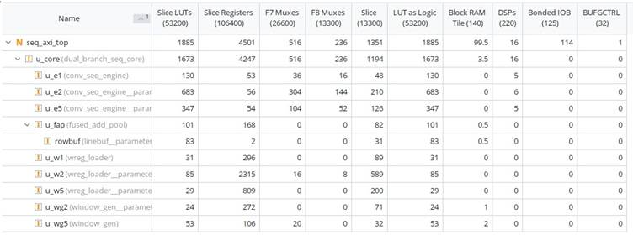
FPGA RESOURCE UTILIZATION AND EVALUATION
Resource utilisation of Standard Convolution
The utilization report for the seq_top design indicates 1,885 LUTs, 4,501 registers, 16 DSPs and 99.5 block-RAM tiles.
This lower LUT and DSP usage is consistent with sequential processing, which reuses hardware resources across operations rather than performing multiple operations simultaneously.

Slide 29
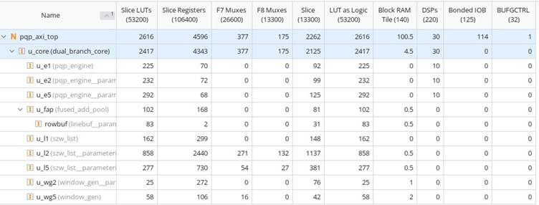
FPGA RESOURCE UTILIZATION AND EVALUATION
Resource utilization of PQP Convolution unit
The utilization report for the pqp_axi_top design indicates 2,616 LUTs, 4,596 registers, 30 DSPs and 100.5 block-RAM tiles.
The LUT and register usage reflects the additional hardware required to support parallel arithmetic, data storage and control operations in the PQP architecture.
The 30 DSPs indicate the use of dedicated arithmetic resources for computation, while the block RAM stores intermediate or input data.

Slide 30
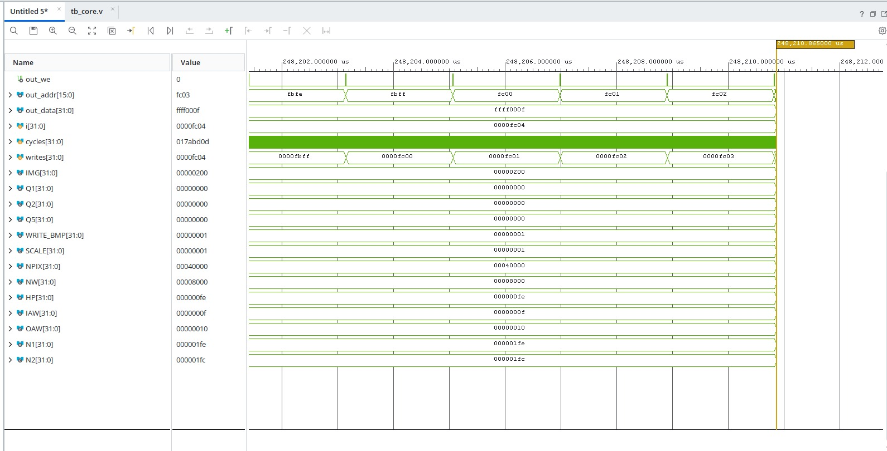
SIMULATION OF PQP+SZW
Simulation time: 248210.865us
Cycles : 24821005

Slide 31
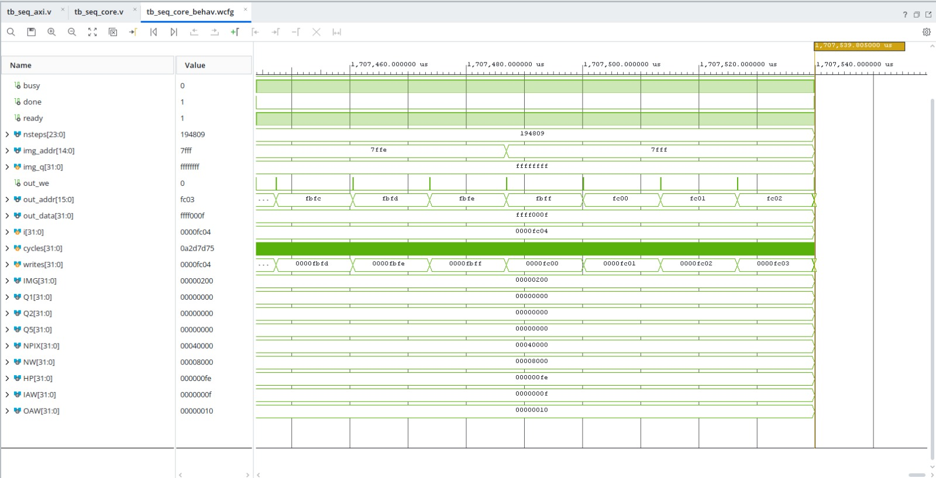
SIMULATION OF STANDARD CONVOLUTION
Simulation time: 1707539.805us
Cycles : 170753397

Slide 32
COMPARISON OF PQP AND STANDARD CONVOLUTION
Efficiency of PQP+SZW over Standard convolution
Reduced processing latency
Faster execution
Enhanced parallelism
Improved computational efficiency
Optimized feature extraction
FPGA suitability
 | PQP + SZW | STANDARD
DSP (220) | 30 (13.6%) | 16 (7.27%)
LUTs (53200) | 2616 (4.91%) | 1885 (3.54%)
Registers (106400) | 4596 (4.32%) | 4501 (4.23%)
Cycles Per frame | 24.8M | 170.8M
Time at 100MHz | 248 ms | 1707 ms
The table compares the proposed PQP with SZW architecture against standard sequential convolution. We can infer that the proposed architecture achieves approximately 6.89 times faster processing, with an 85.5% reduction in processing cycles, at the cost of higher LUT and DSP utilisation.

Slide 33


